Slide 1

CS 533 INTRO TO DATA SCIENCE
Michael Ekstrand

Slide 2
DISTRIBUTIONS

Slide 3

Learning Outcomes
Understand the idea of a distribution
Identify parameters and statistics of a distribution
Notebook has details!
Photo by Emiliano Vittoriosi on Unsplash

Slide 4
Numeric Distributions
We’re going to focus on distributions of numeric variables
Both discrete and continuous
Categorical: encoded to 0, 1, etc.

Slide 5
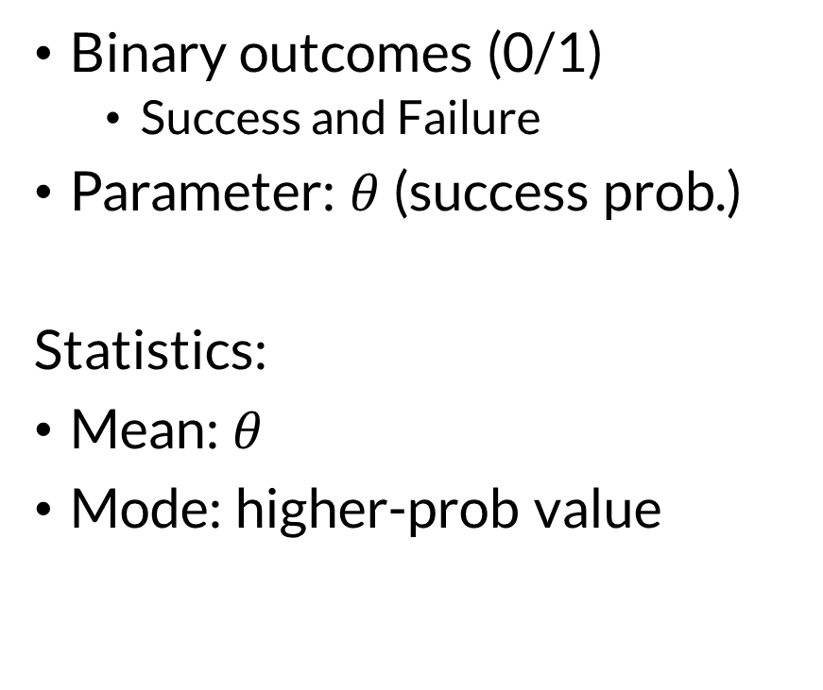
Bernoulli Distribution
Binary outcomes (0/1)
Success and Failure
Parameter: $θ$ (success prob.)
Statistics:
Mean: $θ$
Mode: higher-prob value

Slide 6
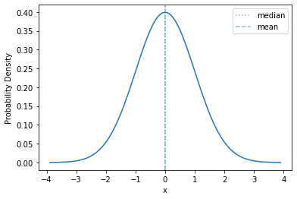
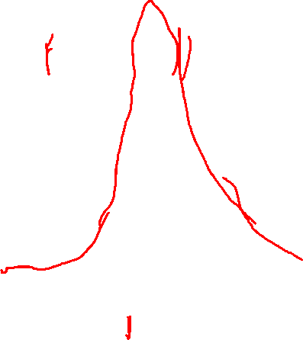
Characterizing Distributions
Parameters:
location, scale, shape

Slide 7
Characterizing Distributions
Parameters:
location, scale, shape
Density or mass function
Support (range it’s defined over)
Underlying random process
Key Statistics
Mean (first moment)
Standard deviation or variance
Variance is second central moment
Median (50th %ile)

Slide 8
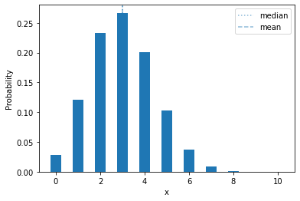
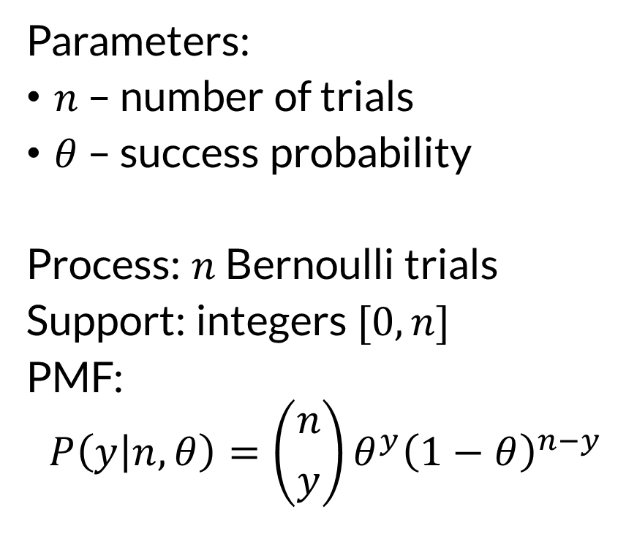

Binomial
Parameters:
$n$ – number of trials
$θ$ – success probability
Process: $n$ Bernoulli trials
Support: integers $[0,n]$
PMF:
$$P\left(y | n,θ\right)=\left({n \atop y}\right)θ^{y}{\left(1−θ\right)}^{n−y}$$
Binomial(10, 0.3)

Slide 9
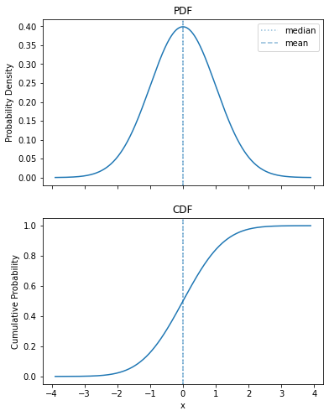
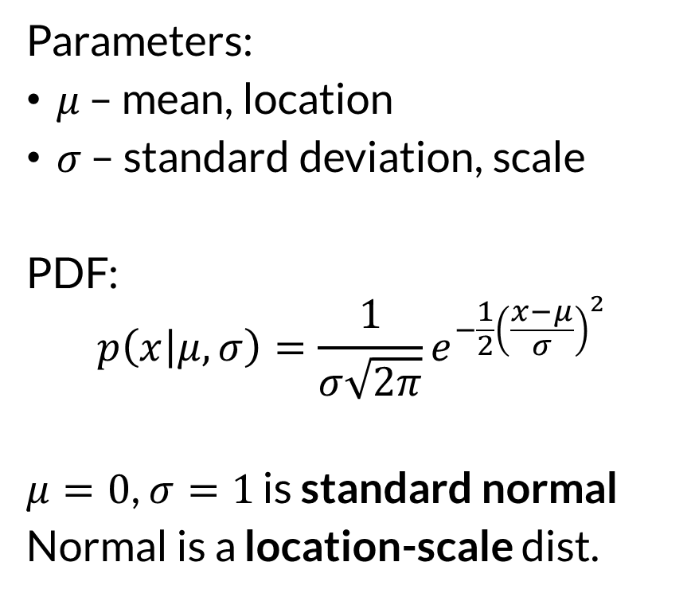

Normal (Gaussian)
Parameters:
$μ$ – mean, location
$σ$ – standard deviation, scale
PDF:
$$p\left(x | μ,σ\right)=\frac{1}{σ\sqrt{2π}}e^{−\frac{1}{2}{\left(\frac{x−μ}{σ}\right)}^{2}}$$
$μ=0$, $σ=1$ is standard normal
Normal is a location-scale dist.

Slide 10

Wrapping Up
Random variables are often described by probability distributions, which may have parameters.
There are many standard probability distributions.
See notebook + resources for more!
Photo by JOSHUA COLEMAN on Unsplash

